Slide 1

Experimental study and modeling of bicycle flow
Rui Jiang
Beijing Jiaotong University

Slide 2
Outline
Introduction
Single-file Experiment
Wide road Experiment
Interactions between Bicycles and Pedestrians
Conclusion

Slide 3
Introduction
As an ecological means of transportation, cycling has a number of advantages over other modes, both for individuals and society.
The percentage of bicycle trips has reached nontrivial levels in some countries, such as 10% in Germany and Sweden, 11% in Finland, 18% in Denmark, and 27% in the Netherlands

Slide 4
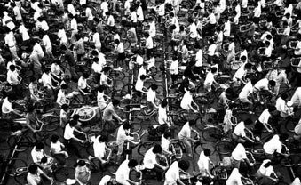
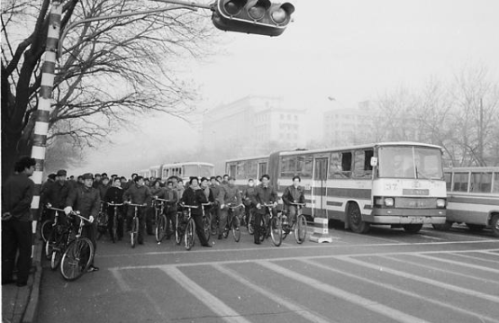
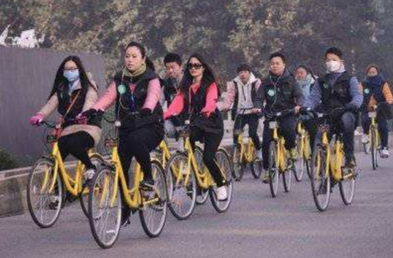
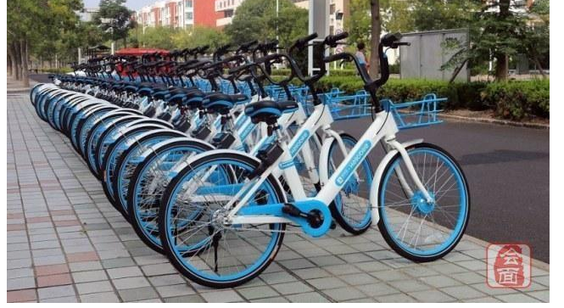
China was once a bicycle kingdom. However, bicycle trips significantly decreases due to rapid motorization.
Recently, due to the emergence of shared bicycle, the percentage of bicycle trips increases again.

Slide 5
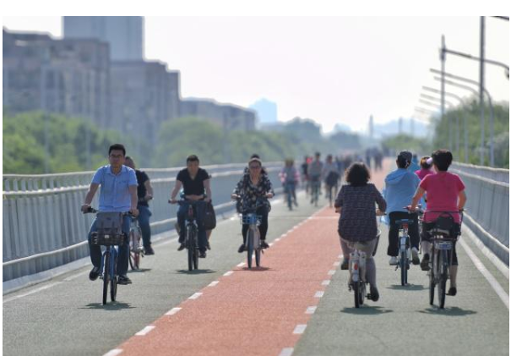
Beijing “bicycle highway”, exclusive for bicycle, opened on 31 May, 2019.
Length 6.5 km, width 6 m, red lane is “tidal lane”.

Slide 6
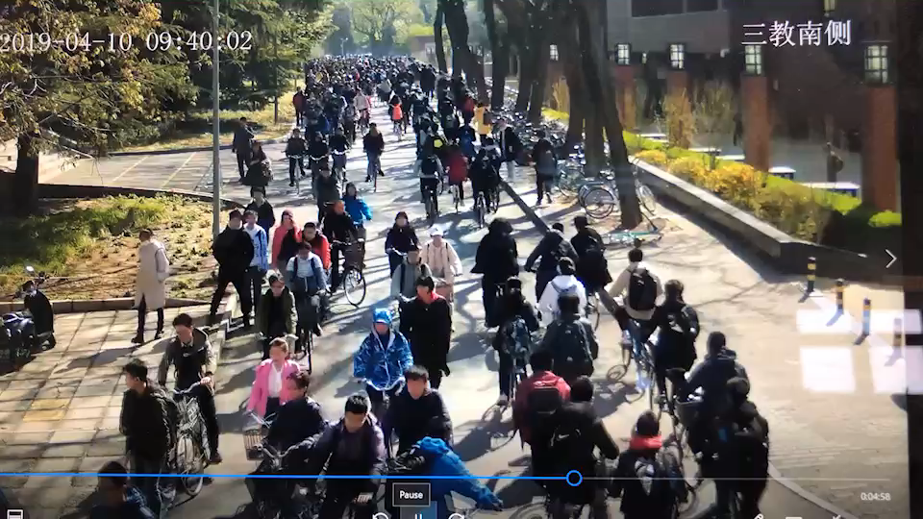
Tsinghua University Campus

Slide 7
Capacity
2,600 bicycles per hour per 3.3-ft (1 m) in a study in Davis, California (Homburger 1976).
Botma and Papendrecht (1991): from 3,000 to 3,500 bicycles per hour per 2.6-ft (0.78 m) lane.
Raksuntorn and Khan (2003): 4,500 bicycles per hour of green per 8-ft (2.4 m) wide bicycle lane.
Miller and Ramey (1975): somewhere above 700 bicycles/hr/ft.
Gould and Karner (2009): 792 bicycles/hr/ft.
The capacity in China was reported to be 5,250 bicycles/hr in Shanghai and 5,220 bicycles/hr in Beijing for a 2.5-m pathway (Xu 1992; Liu, Shen, and Ren 1993)

Slide 8
Modeling
Mutlivalue cellular automaton (CA) models (Jiang, Jia, and Wu 2003; Jia et al. 2007).
Gould and Karner (2009) developed a two-lane CA model.
Vasic and Ruskin (2012) have proposed a CA model to simulate traffic including cars and bicycles on a stretch of road and an intersection causing conflict between cars and bicycles sharing a lane.
Zhang, Ren, and Yang (2013) have proposed a CA model and a gas dynamics model to simulate mixed traffic of bicycles and electric bicycles.
Zhao et al. (2013) developed a CA model and calibrated the model with the use of the field data.

Slide 9
Safety (Dozza et al., 2016; Hamann and Peek-Asa, 2017)
Level of service (Allen-Munley et al., 2004; Wang et al., 2008; Elias, 2011; Dozza and Werneke, 2014),
Effect of bicycles on vehicle traffic flow (Zhao et al., 2013; Luo et al., 2015; Zhang et al., 2017).
Empirical studies concerning the traffic dynamics of bicycle flow are very limited

Slide 10
Experiment
Since the volume of bicycle flow is usually not high enough, the opportunities to observe the full range of traffic conditions are very limited. Navin (1994) carried out an experimental study on bicycle traffic.
Children ages 11–14 were recruited from elementary schools and were filmed while riding on a 4-m-wide 125-m-long oval track behind a lead cyclist.
They were instructed to “ride behind and fill in the space behind the pace setter at a spacing they considered safe and comfortable” .
The fundamental diagram has been presented and the maximum flow occurs at about 72 bicycles/min/m, at a speed of about 14 km/hr and a density of about three bicycles per 10 m2.

Slide 11
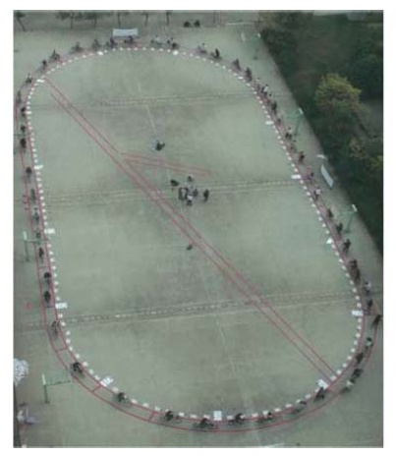
Single-file experiment setup
we use an oval-like course on four neighboring basketball courts, with 29 m straight sections joined by 14 m circular curves. The total length of the course is 146 m. The width of the course is about 0.8 m
Three times on November
3, 2009, November 7, 2009, and April 19, 2010, respectively. The weather was sunny the first time, sunny/cloudy the second time, and a little rainy the third time. Some riders hold up an umbrella with one hand while riding in the third experiment

Slide 12
We also investigate the bicycle flow of an on-ramp system. The distance from the entrance of the main track to the on-ramp is 34 m. The experiment has been conducted only once, on November 7, 2009.

Slide 13
Experimental results
fundamental diagram exhibits the common feature as vehicular flow and pedestrian flow
there exists a critical density of about 0.37 bicycles/m.

Slide 14
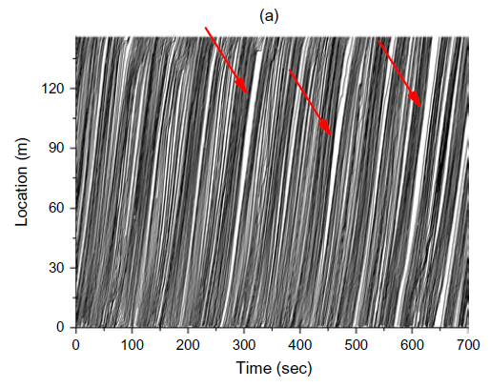
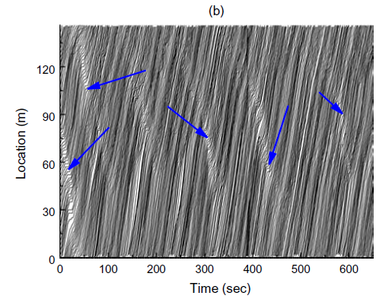
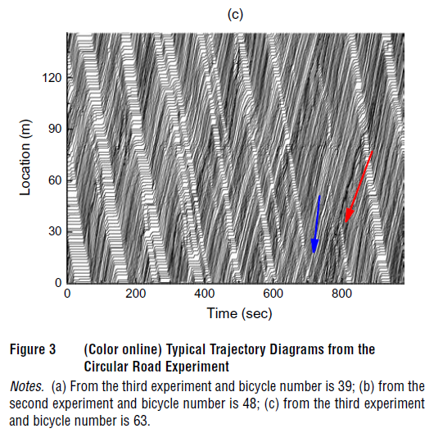
Below the critical density, the bicycle flow is
quite stable. Figures 3(a) and 3(b) show two such typical trajectory diagrams. One can see that even if small jams have occurred from time to time, they will soon disappear, as shown by the blue arrows in Figure 3(b).
Moreover, as shown by the red arrows in Figure 3(a), some large gaps occur from time to time when the density is far below

Slide 15


Slide 16
When the density is above the critical density, the bicycle flow becomes unstable as shown in Figure 3(c). Traffic jams exist in the bicycle flow. Some riders walked instead of riding even if outside of the jams because the riding speed is approximately equal to walking speed.
Even if the jam occasionally dissipates (in the vicinity of 700 seconds as shown by the blue arrow), it soon appears spontaneously (in the vicinity of 800 seconds as shown by the red arrow). When the density further increases, the jams cannot dissipate.

Slide 17
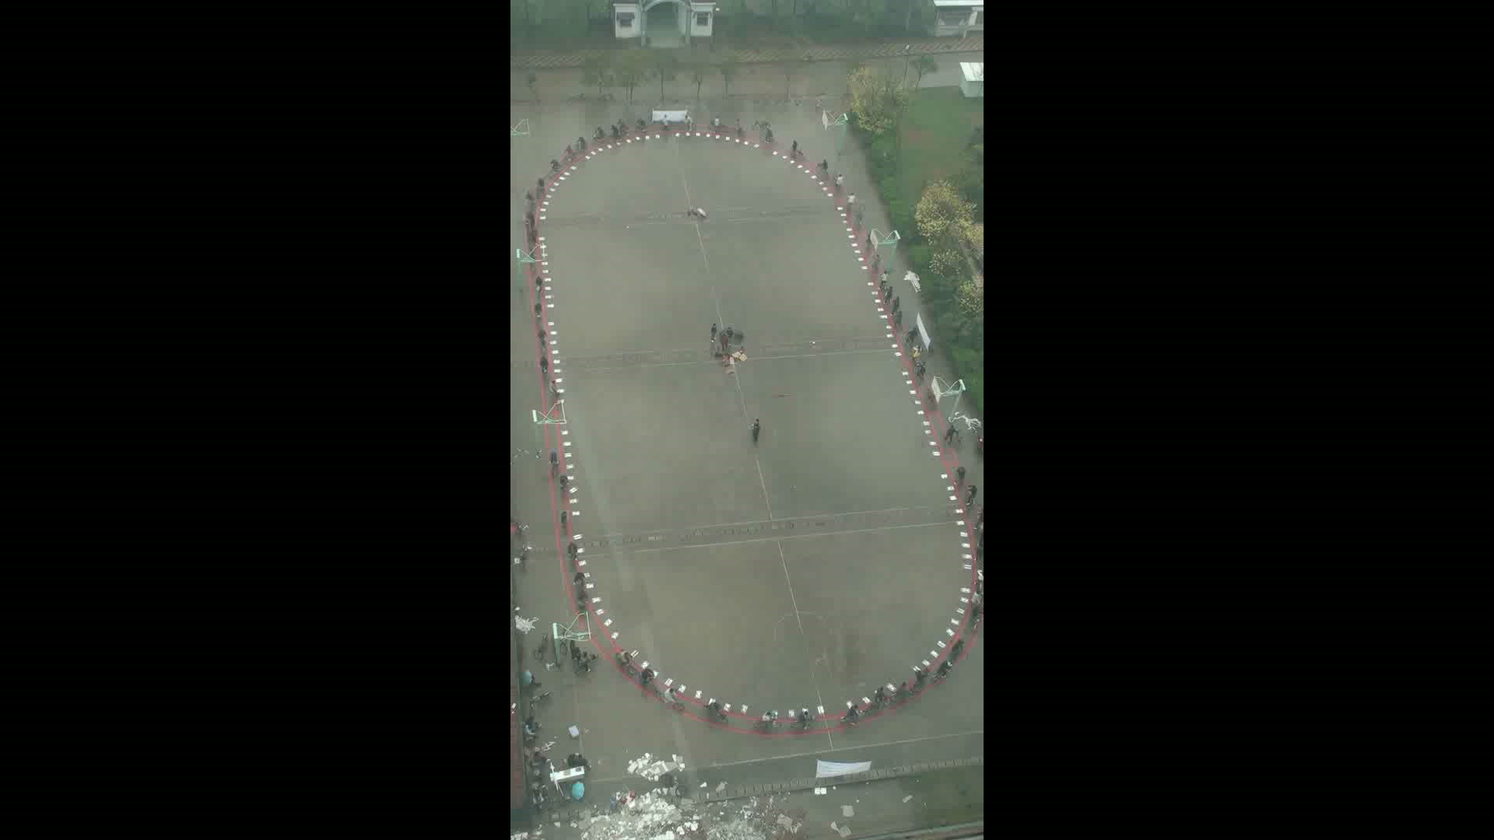

Slide 18
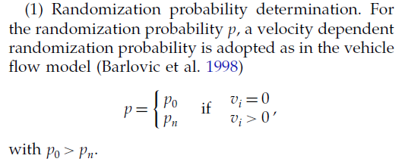
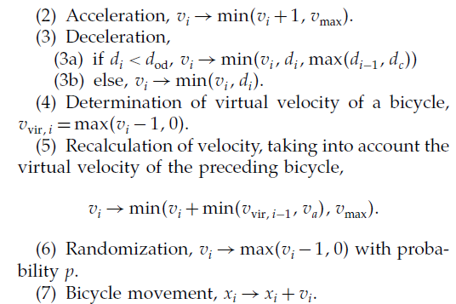
Model
The anticipation effect is considered in deceleration rule (3a), i.e., when a bicycle and its preceding one are within an operating distance dod, the bicycle’s velocity is decided not only by its spatial gap but also by the preceding one’s spatial gap. This reflects the fact that when the spatial gap of its preceding car is small, bicycles tend to move more slowly than allowed by its spatial gap to avoid unrealistic, oversized deceleration
in the next time step. The parameter dc is a parameter indicating that the preceding bicycle’s spatial gap has a limited effect on the bicycle compared
with its own spatial gap.
va denotes the maximum limit of virtual
velocity

Slide 19
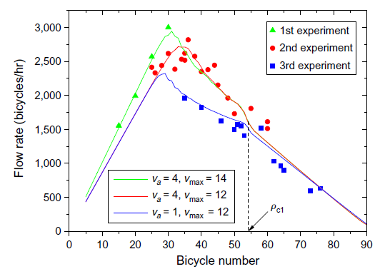
Simulation results
the simulation results are in agreement with the experimental ones

Slide 20
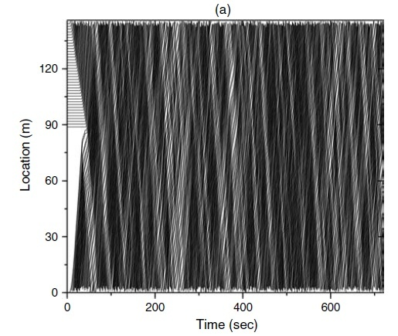
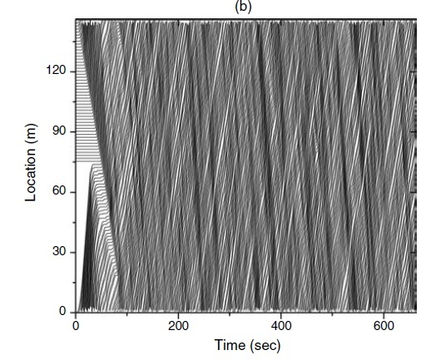

Slide 21
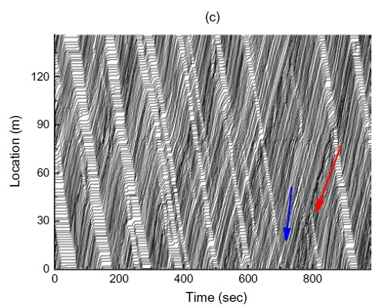
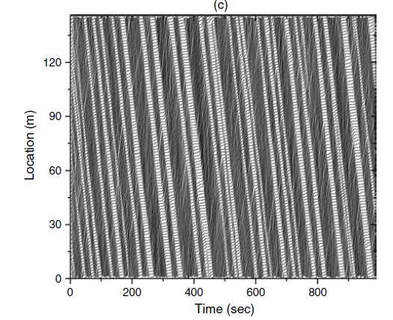

Slide 22
We fixed the inflow rate of the main track at about 2,200 bicycles/hr (unless the congestion has
spilled back to the entrance) by letting one bicycle in every 1.64 seconds (which is achieved via a computer program, that buzzes every 1.64 seconds), and changed the on-ramp flow rate. The statistical period is one minute. One can see that the outflow rate on the main track is approximately equal to the capacity of 2,730 bicycles/hr when the on-ramp flow is above 600 vehicles/hr. Under such circumstances, congestion occurs on the main track, and no capacity drop is observed. The experiment shows that the on-ramp flow seldom exceeds 1,020 bicycles/hr (17 bicycles/min), because otherwise the on-ramp will be congested itself.

Slide 23
Publications
Jiang R et al. (2017) Traffic Dynamics of Bicycle Flow: Experiment and Modeling. Transportation Science 51: 998-1008
Mai X, Lv W, Wei XG, Song WG, Jiang R (2012) Analyzing the characteristics of unidirectional bicycle movement around a track based on digital image processing. 9th Asia-Oceania Symposium on Fire Science and Technology, Oct 17-20, 2012, Hefei, China.

Slide 24
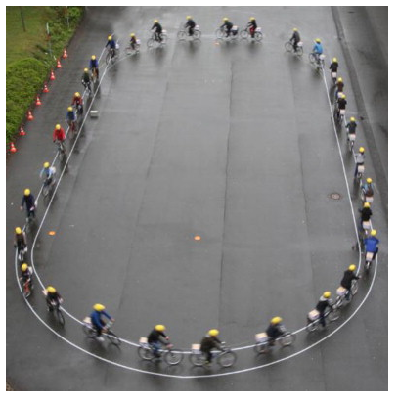
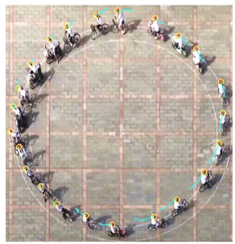
Relevant work
Zhang J, Mehner W, Holl S, Boltes M, Andresen E, Schadschneider A, Seyfried A (2014) Universal flow-density relation of single-file bicycle, pedestrian and car motion. Phys. Lett. A 378: 3274-3277.
Zhao YX, Zhang HM (2017) A unified follow-the-leader model for vehicle, bicycle and pedestrian traffic. Transport. Res. B 105: 315-327.

Slide 25
Alexandra Gavriilidou, Maria J. Wierbos, Winnie Daamen, Yufei Yuan, Victor L. Knoop, and Serge P. Hoogendoorn (2019). Large-Scale Bicycle Flow Experiment: Setup and Implementation. Transportation Research Record
Maria J. Wierbos, Victor L. Knoop, Flurin S. Hanseler, and Serge P. Hoogendoorn (2019). Capacity, Capacity Drop, and Relation of Capacity to the Path Width in Bicycle Traffic. Transportation Research Record

Slide 26
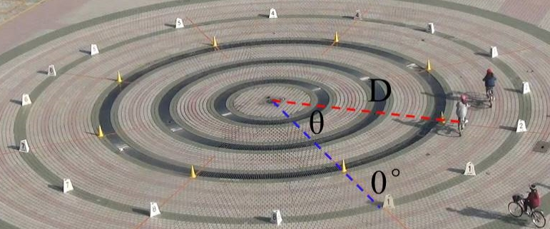
Wide road experiment setup
The inner radius and outer radius of the track were 8 m and 11 m respectively. The area of the experimental track was thus approximately 180 m².

Slide 27
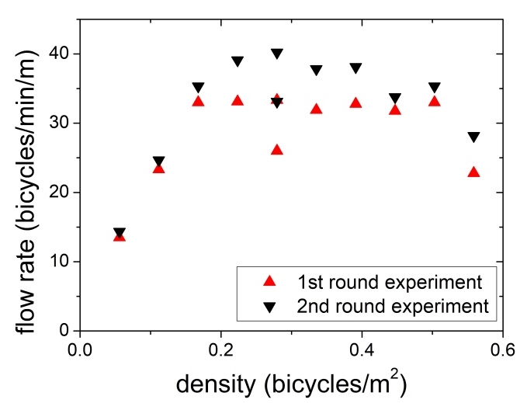
Experimental results
with the increase of the global density, the cyclists gradually form an increasing number of lanes. In this way, the bicycles are staggered so that the space
between them can be utilized more efficiently on the wide track.
When the density is smaller than 0.17 bicycles/m2 (30 cyclists), the bicycles exhibit a free flow state, in which the flow rate increases with density. The flow rate then becomes almost constant until the density reaches 0.50 bicycles/m2 (90 cyclists). In the 100-participant experiment, as the bicycle flow becomes congested, the flow rate begins to decrease.

Slide 28
To quantify the above phenomenon, we introduce the weight density at given polar radial distance Dr as proposed in Helbing et al. (2007)
Here Di is the distance between cyclist i and the track center. β is a parameter, and is set to 0.2.
The index of weight density reflects the cluster degree in the radial direction

Slide 29
Although the speed decreases as more bicycles occupy the track, the cyclists respond by forming more lanes to allow them to move side-by-side. Therefore, the longitudinal density does not increase as quickly as in single-file bicycle flow. This utilization of space restrains the decrease of the flow rate, allowing it to remain essentially constant across a wide range of densities.
When the number of bicycles exceeds 90, no new lanes can be formed because of insufficient track width. As a result, the flow rate begins to decrease
With increasing global density, the number of peaks increases from 1 to about 5, which means that the number of lanes formed by bicycles increases.

Slide 30
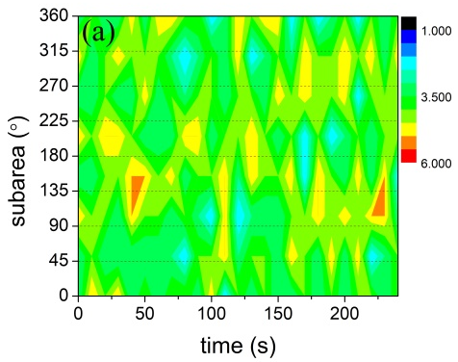
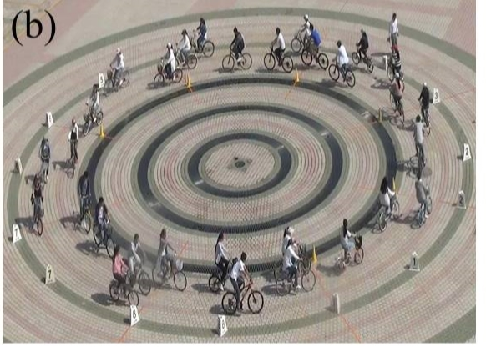
To study the evolution of bicycle flow at different densities, we divide the track into eight equal areas. We show the evolution of the number of cyclists in the eight subareas
Results of a 30-participant experimental run. The distribution is relatively homogeneous.

Slide 31
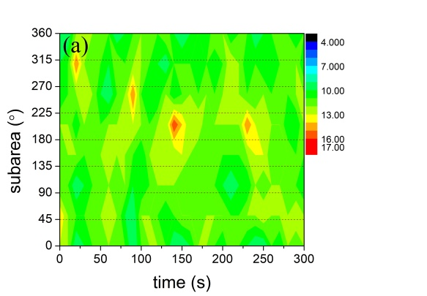
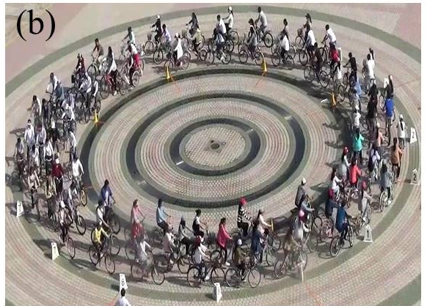
Results of a 90-participant experimental run. The distribution is also relatively homogeneous.

Slide 32
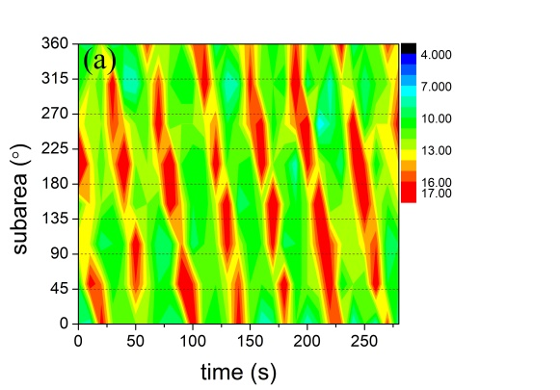
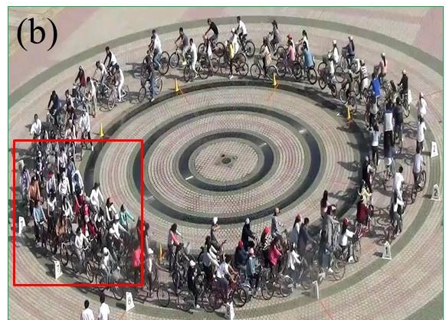
Results of a 100-participant experimental run. The stop-and-go wave emerges.

Slide 33
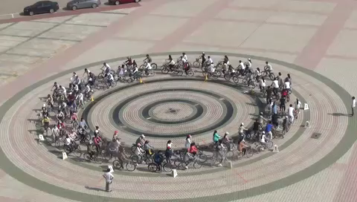
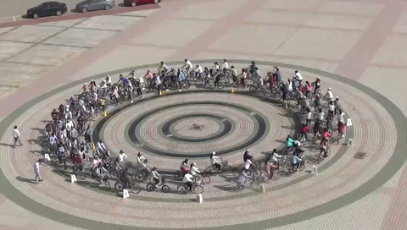
90 participants
100 participants

Slide 34
Model
We assume that the minimum comfortable space required by a cyclist is formed by three circles

Slide 35
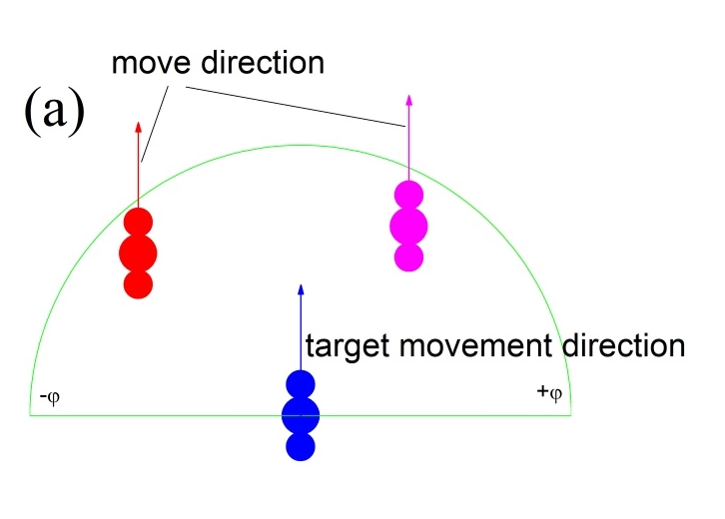
It is assumed that a cyclist chooses his/her movement direction in the range

Slide 36
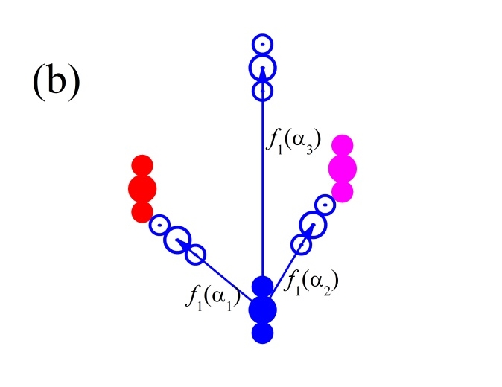
For all candidate directions α in this range, cyclist i evaluates the distance to the first collision f1(α), considering other cyclists’ locations. To calculate f1(α), the model assumes that cyclist i moves at the target speed vmax along the candidate direction α, and the other cyclists do not move.
cyclist i will collide into another cyclist along candidate directions α1 and α2. In contrast, cyclist i will not collide into any cyclist along direction α3. In the former two directions, f1(α) is set to the
distance to the first collision in direction α. If no collision will occur in direction α (e.g., direction α3) or f1(α) exceeds a default maximum value dmax, then f1(α) is set to f1(α) = dmax.

Slide 37
For potential collisions with the track boundaries, f2(α) is calculated in a similar way
Moussaïd M, Helbing D, Theraulaz G (2011) How simple rules determine pedestrian behavior and crowd disasters. Proc. Natl. Acad. Sci. USA 108: 6884-6888.

Slide 38
We split the vector into two vectors, along the direction of , and vertical to . We assume that is due to acceleration (pedaling) or deceleration (e.g., cessation of pedaling, or braking), and
is due to turning of the handlebar. Thus, when , the cyclist is accelerating, and when , the cyclist is decelerating.

Slide 39
Therefore, the resulting acceleration equation is
τ2 , τ3 , τ4 are relaxation times corresponding to acceleration, deceleration, and turning, respectively. aa and ad are the maximum acceleration and maximum deceleration of the bicycle.

Slide 40
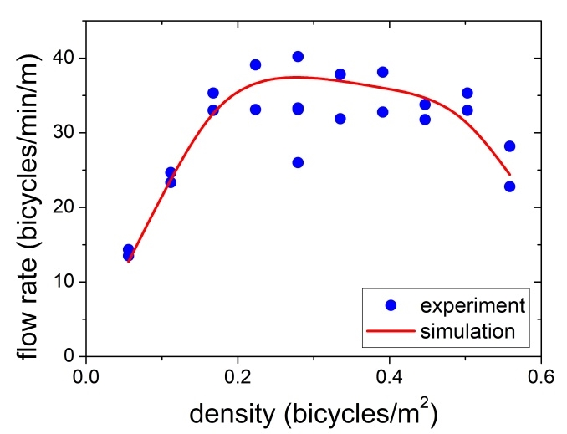
Simulation results
the simulation results are in agreement with the experimental ones

Slide 41
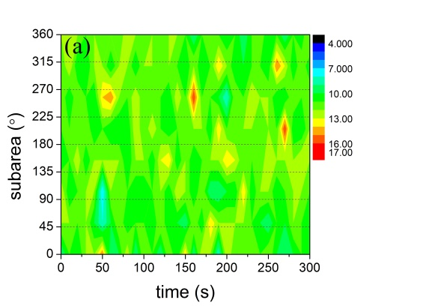
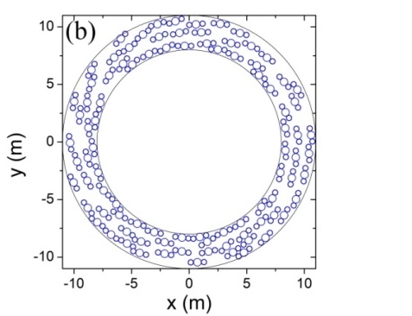
Results of a 90-participant simulation run

Slide 42
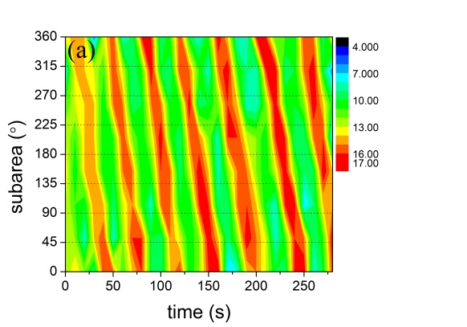
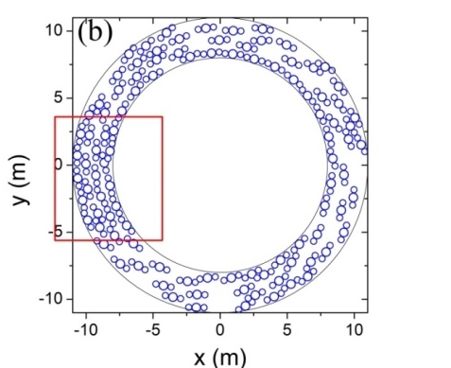
Results of a 100-participant simulation run

Slide 43
Experiment on interactions
The mixed flow of pedestrians and bicycles can be observed on streets.
Kwon et al. (1997) studied the interactions of pedestrians, bicycles, and cars in narrow urban streets in Tokyo and observed that a shorter distance between individuals resulted in higher likelihood of conflict.
Zacharias (1999) found that in Amsterdam, many pedestrians and bicycles shared the street Leidsestraat. As the density on this street increased, the distance between pedestrians was observed to decrease, but the distance between bicycles and pedestrians was unchanged.
Bernardi and Rupi (2015) found that the co-presence of pedestrians and bicycles in Bologna, Italy reduced the bicycle speed by 10% to 27%.
Kang et al. (2013) investigated mixed flow in Beijing, Shanghai, Hangzhou, and Hefei and observed that bicycles had a significant negative effect on pedestrian’s perceptions of level of service.
Yu et al. (2012) found that the proportion of pedestrians significantly affects the movement of bicycles (i.e., the bicycle speed in mixed flow is 50% lower than that in pure bicycle flow).

Slide 44
Zacharias (1999) reported that Amsterdam authorities allowed bicycles to move on pedestrian paths because they thought pedestrians and bicycles could self-organize to avoid collisions.
Unfortunately, few modeling studies of the traffic dynamics of pedestrian-bicycle mixed flows have been published, and even fewer experimental/empirical data have been used to support the reliability of the modeling of the studies that do exist.

Slide 45
Experiment on interactions
Same track as before.
Six experimental runs were performed. In each run, number of pedestrians equal number of bicycles.
The participants were initially distributed randomly on the track.
Pedestrians were initially instructed to walk in the anti-clockwise or clockwise direction, and cyclists were instructed to ride only in the anti-clockwise direction.
After 3 to 5 minutes, the participants were instructed to stop. The pedestrians were then instructed to turn around and walk, and the cyclists were instructed to continue riding anti-clockwise.

Slide 46
This arrangement may have been because the cyclists were continuously turning in the experimental process, and if they moved close to the inner boundary to avoid pedestrians, they would have had to increase their angle of turning. This would have been a less comfortable operation than the reduced angle of turning required when they rode closer to the outer boundary. In contrast, the pedestrians had more flexibility of movement, and could thus cope more easily with the increased turning angle required when traveling on the inner lane.
Any density of bicycles and pedestrians separated very rapidly into their own lanes. The pedestrians always walked in the inner lane, and the cyclists always rode in the outer lane.

Slide 47
In the unidirectional flow scenario, it was frequently observed that because the pedestrians could not
see bicycles behind them, three or more pedestrians walked side-by-side. One can also observe that the bicycles sometimes occupied nearly the whole width of the track. As a result, the width of the
pedestrian/bicycle lane was not uniform.
In contrast, in the bidirectional flow scenario, both the bicyclists and the pedestrians actively avoided each other. Pedestrians were noted to usually walk individually, or two pedestrians were seen to walk side-by-side. Three or more pedestrians were seldom observed to walk side-by-side. The widths of both bicycle lanes and pedestrian lanes were largely uniform during bidirectional flow

Slide 48
The pedestrian flow rate in unidirectional flow was always larger than that in bidirectional flow because in the bidirectional flow scenario, the pedestrians could see the oncoming bicycles and therefore attempted to avoid them. This collision-avoidance behavior limited the pedestrians’ walking speed.
However, in unidirectional flow the pedestrians could not see the bicycles, and they thus walked less conservatively.
The bicycle flow rates at low densities were essentially the same under the two scenarios, whereas at high densities, the bicycle flow rate in the unidirectional scenario was a little larger.

Slide 49
In unidirectional flow, as the flow density increased, the flow rate of bicycles varied less than that of pedestrians. The pedestrian flow rate was lower than bicycle flow rate at low densities, but higher at high densities.
In bidirectional flow, the trend was similar to that observed in unidirectional flow, with the bicycle flow rate being greater at low densities and lower at high densities.

Slide 50
modelling
Movement in the no-contact condition
Movement in the contact condition
When a pedestrian/cyclist’s circle contacts circle of a cyclist/pedestrian traveling in the opposite direction, the pedestrian/cyclist will bypass the contacted cyclist/pedestrian.
If more than one circle of a cyclist contacts the circle of another pedestrian/cyclist, the desired direction is the resultant direction of the contacted multi-circles

Slide 53
If a pedestrian’s/cyclist’s circle contacts that of other pedestrians/cyclists in the same direction, the pedestrian/cyclist behind (the contacted ones are in the view range of the behind pedestrian/cyclist) will stop and wait for the pedestrian/cyclist in front to move forward.
If a pedestrian/cyclist’s circle contacts the circles of other pedestrians/cyclists moving in both directions at the same time, the pedestrian/cyclist will stop until the pedestrians/cyclists whose circles he/she has contacted, that are in front and moving in the same direction, move away

Slide 55
Simulation results

Slide 58
Conclusion
We have experimentally studied the unidirectional bicycle flow and interactions between pedestrians and bicycles.
Above the critical density (0.37 bic/m for single file bicycle flow, 0.5 bic/m2 for wide road bicycle flow), a stop-and-go wave spontaneously emerges.
The existence of a roughly constant flow across a wide range of densities on wide road.
The widths of the pedestrian lane and the bicycle lane were found to be more uniform during bidirectional flow. The pedestrian flow rate was higher in the unidirectional flow scenario than in the bidirectional flow scenario.
The proposed models can reproduce the experimental results

Slide 59
Thanks for your attention!

